Slide 1
Product Classification using Text and Multimodal
Embedding extraction

Slide 2
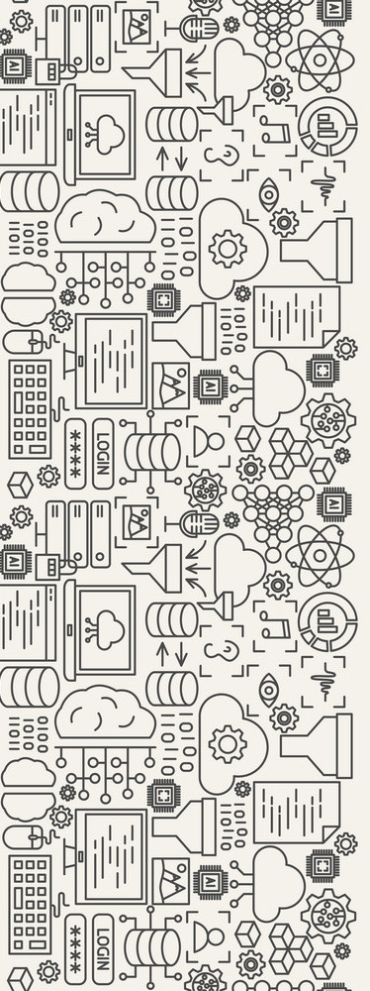
Hello!
I am Ishrat Syed
I am currently pursuing my MSc in AI from Dublin City University
You can find me at:
syedishrat110@gmail.com

Slide 3
1.
The Problem of Product Categorization
Let’s start by enhancing our understanding of the problem

Slide 4

Introduction
In the realm of e-commerce, it is crucial for brands to deliver a seamless user experience to thrive and accurate product classification and categorization are key components in achieving this goal
Products are associated with metadata, including its title, image, description, top and bottom categories, color, and other attributes provided by the seller.
Identifying the best category for the product based on these meta data remains a crucial problem in e-commerce industry

Slide 5
2.
Literature review
Learning from others expands our knowledge and accelerates our growth

Slide 6
Literature review
Lightweight methods for large-scale product categorization - Cortez et.al.
Examined text-based, image-based, and hybrid approaches
Text-based methods involve analyzing product titles, descriptions, and other textual attributes.
Keyword-based classifiers are a popular text-based method, relying on predefined lists of keywords and phrases associated with specific product categories.
Hybrid approaches combine text-based and image-based methods for product categorization.
These approaches utilize both textual and visual features to determine the category of a product.
An example of a hybrid approach is using a text-based classifier trained on textual attributes and an image-based classifier trained on product images.
Text-based methods are simple to implement but may have limitations in accuracy.
Image-based methods can be powerful but require significant computational resources.
Hybrid approaches provide a balance between accuracy and efficiency.

Slide 7
Literature review
A multimodal fusion model for e-commerce product classification - Y Bi et.al
Large scale multimodal classification using an ensemble of transformer models and co-attention - Chordia et.al.
Synerise at sigir rakuten data challenge 2020: Efficient manifold density estimator
for multimodal classification - Basraj et.al
Dataset provided by Rakuten France for the SIGIR 2020 e-commerce workshop included multi-modal product data: product images, French titles, and detailed descriptions.
Task: Predict 27 category labels across four major genres - books, children, households, and entertainment.
Most participants utilized fine-tuning of pre-trained text and image models as feature extractors.
Bimodal fusion mechanisms were proposed to combine predictions from text and image modalities.
Commonly used pre-trained models: BERT for text feature extraction and ResNet for image feature extraction.

Slide 8
Literature review
Multimodal e- commerce product classification using hierarchical fusion - Yashu et.al
Study focused on fine-tuning pre-trained French language models for product categorization.
French language models were fine-tuned separately for each textual modality.
SEResNeXt-50 model was employed to extract features from image products.
Extracted features from different modalities were hierarchically fused using various fusion strategies.
Fusion strategies were used to combine the features and make the final prediction.
Other pre-trained models utilized in this research field include FlauBERT and CamemBERT.

Slide 9
3.
Approach and Methodology
Lets breakdown our approach

Slide 10
The fundamental principles guiding my model
design were portability and scalability. I approached the
task of classification not as a mere competition to achieve the
highest accuracy or F1 score, but rather as a pursuit of a robust
solution that could be deployed in a production environment.

Slide 11
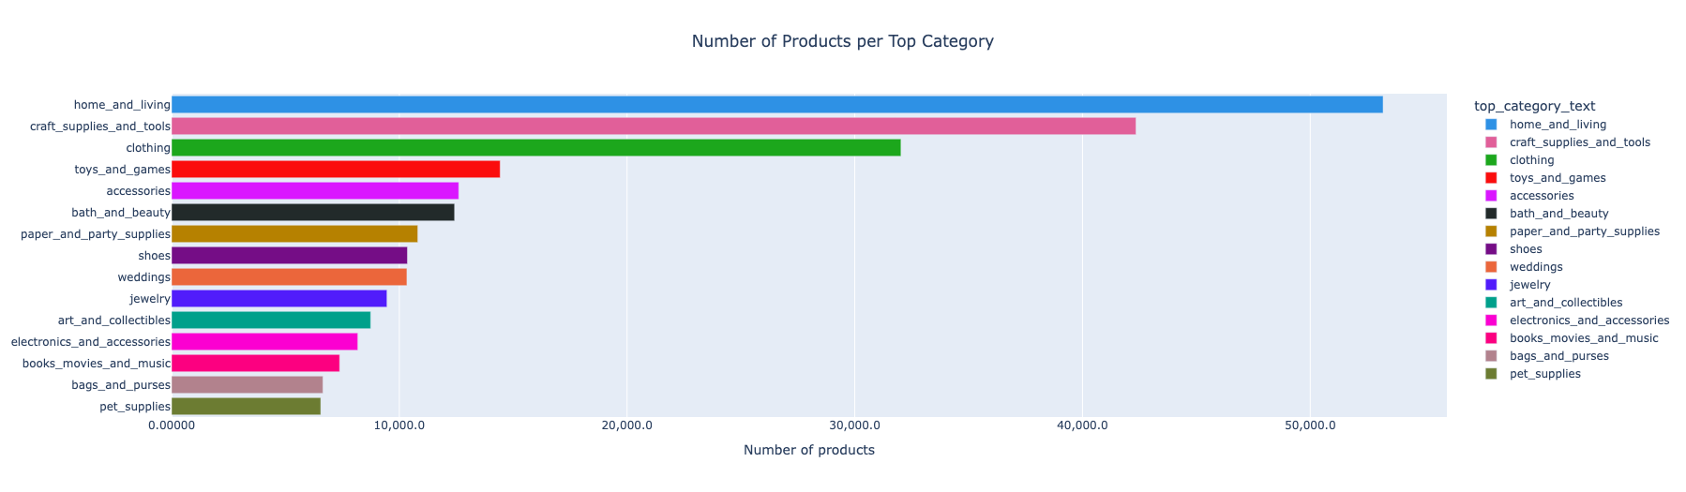
Understanding the Data
The classification task involved categorizing products into three distinct categories: top category, bottom category, and color
Comprehensive data analysis was conducted to understand the dataset and perform the classification approach.
The dataset included text features and actual product images.
The top category consisted of 15 unique categories, with a distribution of products shown in below

Slide 12
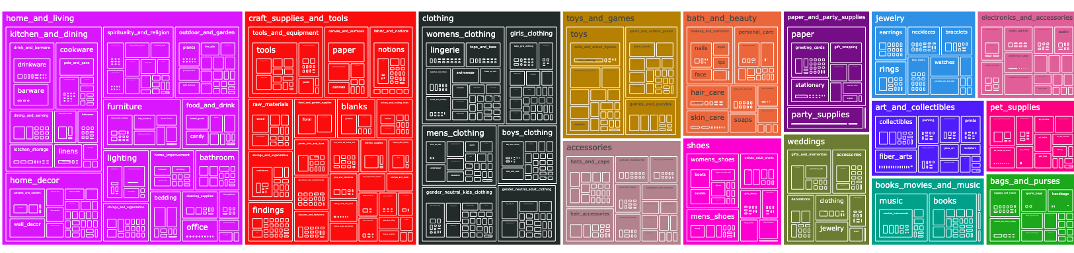
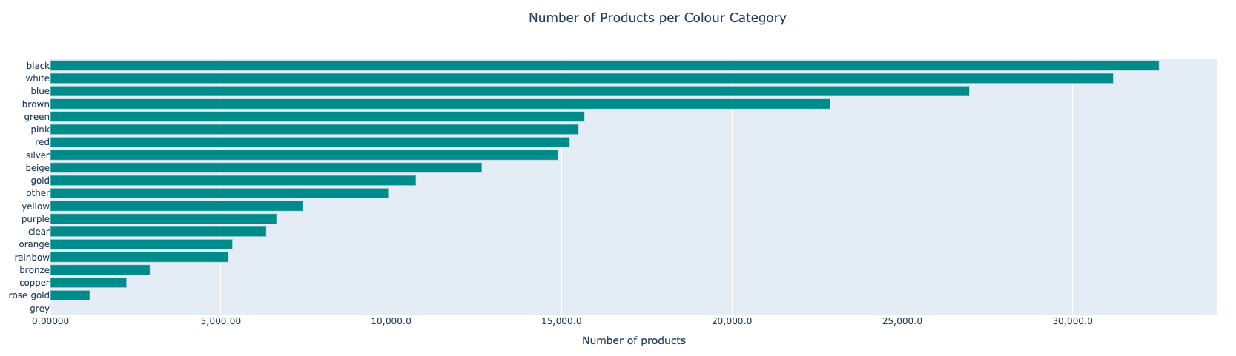
Understanding the Data
The bottom category exhibited a hierarchical structure with over 2700 categories.
A treemap visualization was used to gain insights into the hierarchical structure of the bottom category, as depicted in :
The color category encompassed 20 different values, with their distribution shown below.

Slide 13
Feature Extraction and Data Preparation
Three informative text features were chosen: product title, product description, and product tags.
Visual feature used: product images.
Two approaches: unimodal (text data) and multimodal (text + image data)
Unimodal ( text data) used for Categorization of the Top category
Multimodal (text + image data) was used for bottom category and Color
Text data preprocessing included stop word removal, special character removal, tokenization, and lemmatization.
Preprocessed text features used for numeric feature extraction and modeling.

Slide 14
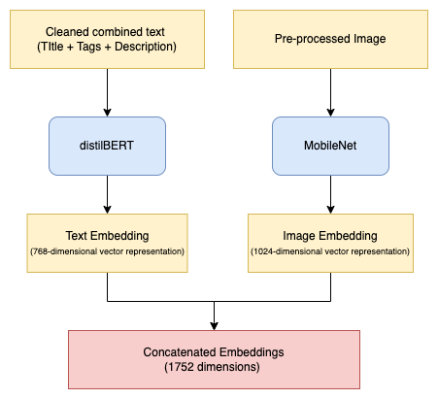
Feature Extraction and Data Preparation
Multimodal approach for text and image data:
Combined cleaned text from the title, tags, and description fields was leveraged.
Transfer learning using pre-trained models was chosen for both text and image embeddings.
Various pre-trained models were compared, including CLIP, ResNet, and EfficientNet.
DistilBERT was selected for text embeddings due to its performance and computational efficiency.
MobileNet was chosen for image embeddings

Slide 15
Modeling Technique and Experiments
Top Category Classification:
Unimodal approach :
Feature engineering was performed using the RAKE algorithm from the Natural Language Toolkit.
The RAKE algorithm identified important phrases from the product title and description based on word co-occurrence patterns.
Extracted keywords were combined with product tags to create a comprehensive representation of the product's features.
After extensive research, LightGBM was chosen as the classification model for top category prediction
Multimodal approach :
Concatenated embeddings of text and image were used to improve the model's performance in the multimodal approach.
Challenges were faced due to the size and complexity of the dataset.
Many approaches required significant computing resources and were not easily scalable for large datasets.
Training models and resource limitations led to suboptimal F1 scores in the multimodal approach.

Slide 16
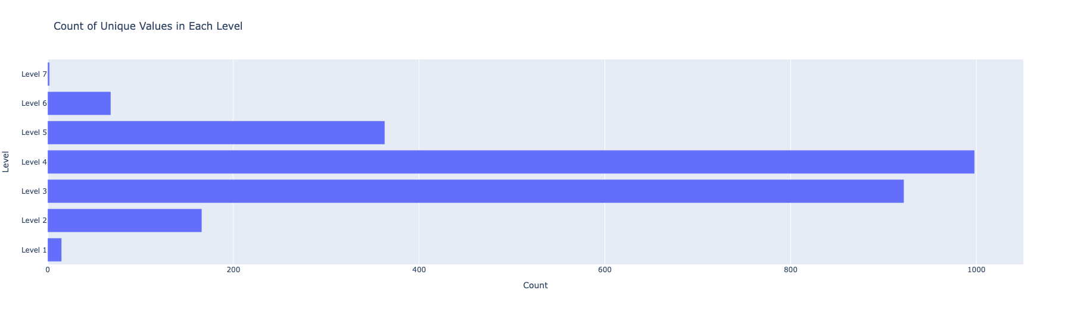
Modeling Technique and Experiments
Bottom Category Classification:
Predicting the bottom category for each product was challenging due to a large number of categories (over 2700) and a limited number of samples per class (11-20 samples)
A simpler approach was chosen for the third experiment, utilizing the K-Nearest Neighbors (KNN) algorithm is applied after TF-IDF vectorization on the text data
KNN with N=5 achieved an F1 score of approximately 0.55
Hierarchical classification was explored as a potential solution by breaking down the problem into smaller subproblems.
The exploratory data analysis (EDA) revealed a hierarchical structure in the bottom category, with multiple levels of depth.
Categories were organized into a hierarchy with up to 7 levels, with levels 3 and 4 having over 900 classes or subcategories, posing challenges in handling the higher number of classes.
Hierarchical classification showed promise but couldn't be fully explored due to time constraints in the project
Notes:
The first two experiments involved a multimodal model using concatenated embeddings from pretrained models like DistilBERT, MobileNet, and CLIP.
However, these complex models yielded suboptimal results and had high time complexity, making it difficult to iterate and tune them efficiently.

Slide 17
Modeling Technique and Experiments
Color Category Classification
Posed challenges due to a highly imbalanced dataset and a limited number of samples for certain colors, particularly gray
Approach 1 : A model was built using raw images and a pre-trained ResNet50 model to extract features and predict the color. This approach achieved an accuracy of around 52%
Approach 2: Feature engineering was performed by extracting color names from the product's title, description, and tags. All standard color names from these fields were combined with tags to train a LightGBM model, resulting in an accuracy of 55%, a further improvement
Individual models did not produce satisfactory results, leading to the decision to build an ensemble of weak and diverse learners
Approach 3: Ensemble approach consisted of two models: LightGBM and a Neural Network built on concatenated embeddings.
Predictions from LightGBM were used when the color was explicitly mentioned in the title, tags, or description of the product.
When color was not mentioned in any of these fields, the model based on concatenated embeddings was used to predict the color category

Slide 18
4.
Results and Future Scope
Lets analyse our approach

Slide 19
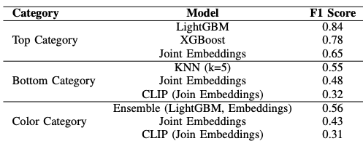
Results and Future Scope
Perform an error analysis to identify classes where the classification models performed poorly.
Augment the dataset with examples where the model is making frequent mistakes or build ensembles with diverse classification strategies to correct mistakes made by a single classifier.
Implement hierarchical classification by building multiple classifiers, one for each level in the bottom category, or train a neural network with multiple output layers for prediction.
Perform clustering on embeddings using algorithms like k-means to group similar products together.
Use the assigned cluster as a feature in the classification model to leverage similarities between products and improve performance.
Build individual models on text embeddings, embeddings, and text+image embeddings.
Create an ensemble by combining the outputs of these models to take advantage of their strengths and improve overall performance

Slide 20
Thank You!
Any questions?

